Slide 1
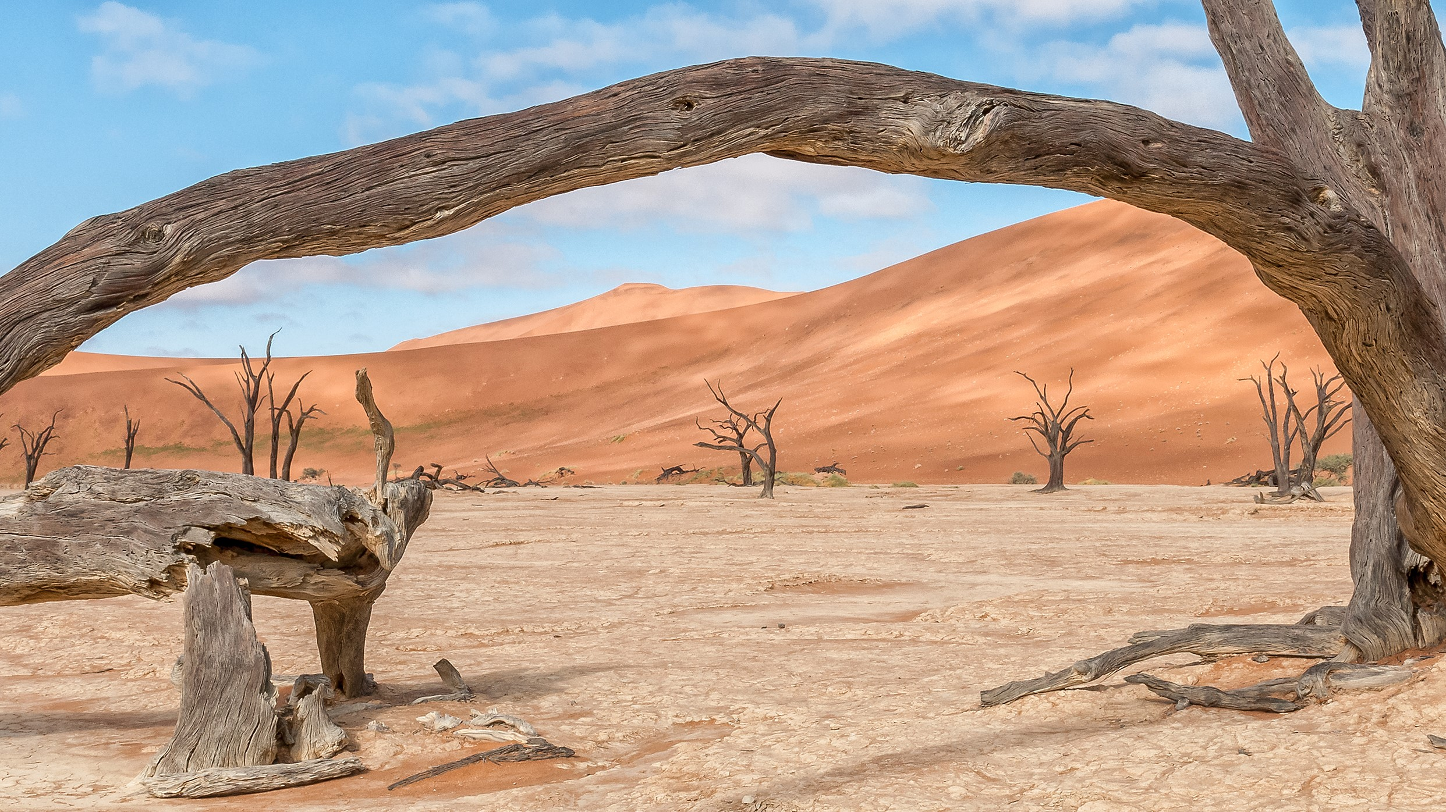

INHLIZIYO YOMUNTU
UYAKWAMUKELA
ALL NATIONS GOSPEL PUBLISHERS
www.angp-hb.co.za

Slide 2

INHLIZIYO YOMUNTU
Le ncwajana yasungulwa eFrance ngo-1732, yabuyekezwa futhi yabhalwa kabusha ukuze iqondise izinkambu zemishini yase-Afrika
Umfundisi J.R. Gschwend ngo-1929, futhi ngemva kwalokho yahunyushwa futhi yanyatheliswa ngaphansi kwelungelo lobunikazi ngezilimi zomdabu ezingaphezu kuka-550, yi-All Nations Gospel Publishers abalisabalalisa namuhla emazweni angu-127 emishini.
Abantu bazo zonke izilimi, izigaba, nezinkolo, baholwa yilencwajana ukuze bezwe iqiniso elijulile, elingokomoya nokubaluleka kwesigijimi sikaNkulunkulu esintwini, njengoba kwavezwa umprofethi uHezekeli, eminyakeni engu-586 ngaphambi kukaKristu,
“Ngizoninika inhliziyo entsha nengqondo entsha,
khona niyakuba ngabantu bami, mina ngibe nguNkulunkulu wenu.”
Hezekeli 36:26-28 .
ALL NATIONS GOSPEL PUBLISHERS
www.angp-hb.co.za

Slide 3

INHLIZIYO YOMUNTU
Njengoba ufunda le ncwadi futhi ufunda ngezithombe zayo, uyokwazi ukubona inhliziyo yakho. Vumela ukukhanya kukaNkulunkulu ukuthi kukubonise isimo senhliziyo yakho. Vuma izono zakho futhi ungakuphiki ukuthi zikhona, ngoba iZwi likaNkulunkulu liyasitshela ukuthi,
8. “Uma sithi asinasono, siyazikhohlisa, iqiniso alikho kithi.
9. Kepha uma sizivuma izono zethu kuNkulunkulu, uyakusigcina isithembiso sakhe, enze ukulunga: Uyosithethelela izono zethu, asihlanze kukho konke ukona kwethu.
7. “… negazi likaJesu, iNdodana Yakhe, liyasihlambulula ezonweni zonke”.
(Funda eyoku-1 Johane 1:1-10.)
Ubuswa nguSathane, noma uNkulunkulu.
Uyisigqila sesono, noma inceku kaNkulunkulu.
Uma isono sibusa impilo yakho, ungasiphiki, kodwa khala kuNkulunkulu.
ALL NATIONS GOSPEL PUBLISHERS
www.angp-hb.co.za

Slide 4

INHLIZIYO YOSONI
ALL NATIONS GOSPEL PUBLISHERS
www.angp-hb.co.za

Slide 5
INHLIZIYO YOSONI
AMEHLO ABOMVU ABUMNYAZI akhuluma ngesono sokudakwa
IPIGOGO : Ukuziqhenya kuziveza ngezindlela eziningi ezahlukene
IMBUZI imele izifiso zomzimba, ukuziphatha okubi kanye nokuphinga
INGULUBE : iziphakamiso zokuziphatha okubi, izinkulumo, izithombe, izincwadi
UFUDU lukhuluma ngobuvila, ukuvilapha ukulalela uma uJesu ekubiza, nobuthakathi.
INGWE: inzondo, intukuthelo, intukuthelo kanye nokubamba amagqubu
INYOKA: udeveli onenkohliso kakhulu, ohlakaniphile, futhi odukisayo
IXELE likhuluma ngesono sokuhaha nothando lwemali
USATHANE unguyise wawo wonke amanga nowabaqamba amanga
Inkanyezi ikhuluma ngonembeza wawo wonke umuntu
ISO LIKANKULUNKULU libona konke okwenzeka enhliziyweni yomuntu
IZILIMI ZOMLILO: UTHANDO LUKANKULUNKULU LUHAQE INHLIZIYO
INGELOSI IMELE IZWI LIKANKULUNKULU
IJUBA LIYIPHAWU LIKAMOYA ONGCWELE
ALL NATIONS GOSPEL PUBLISHERS
www.angp-hb.co.za

Slide 6
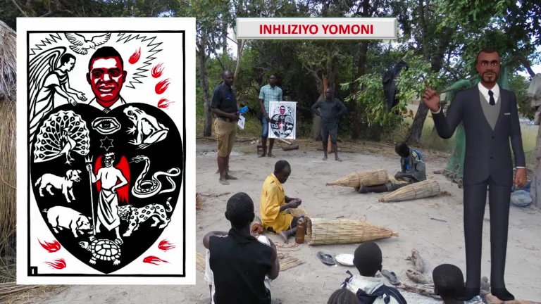

Slide 7

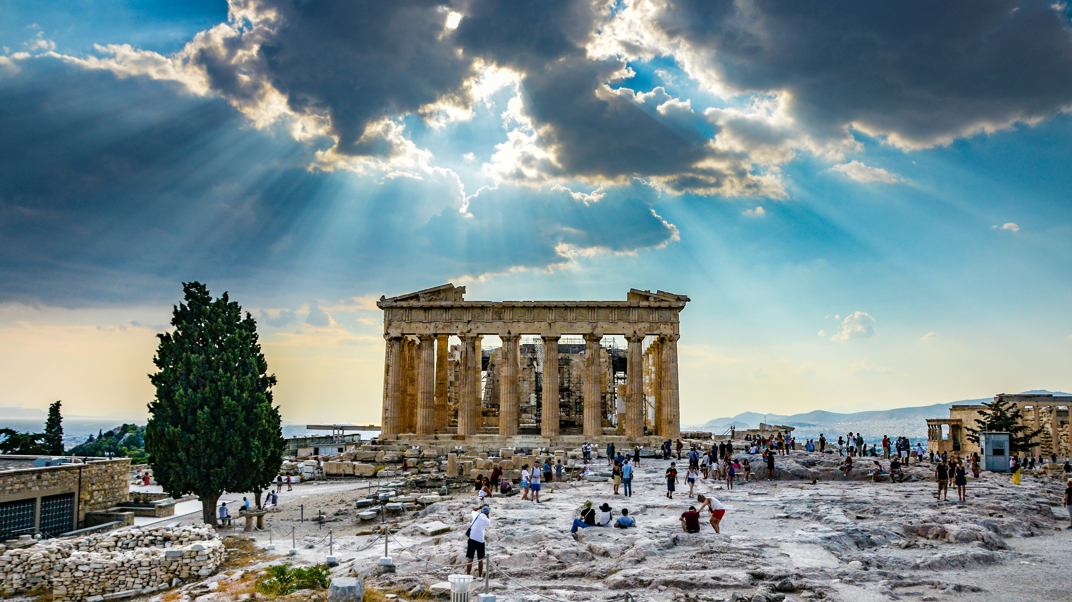
INHLIZIYO EKHOLWE NGESONO
ALL NATIONS GOSPEL PUBLISHERS
www.angp-hb.co.za

Slide 8
INHLIZIYO EKHOLWE NGESONO
Lapha sibona isoni siqala ukunaka umlayezo kaNkulunkulu, nokuvula inhliziyo yaso othandweni lukaNkulunkulu.
UMoya oNgcwele uqala ukukhanya enhliziyweni emnyama nenesono. Ukukhanya kukaNkulunkulu kungena enhliziyweni yakhe ukuxosha bonke ubumnyama. Lapho ukukhanya kukaNkulunkulu kungena, ubumnyama kufanele buhambe.
UJesu wathi: “Mina ngiwukukhanya kwezwe. Ongilandelayo uyakuba nokukhanya kokuphila akasoze ahamba ebumnyameni.
( Johane 8:12 )
“Uma iNdodana (uJesu) inikhulula, niyokhululeka ngempela.”
( Johane 8:36 )
ALL NATIONS GOSPEL PUBLISHERS
www.angp-hb.co.za

Slide 9

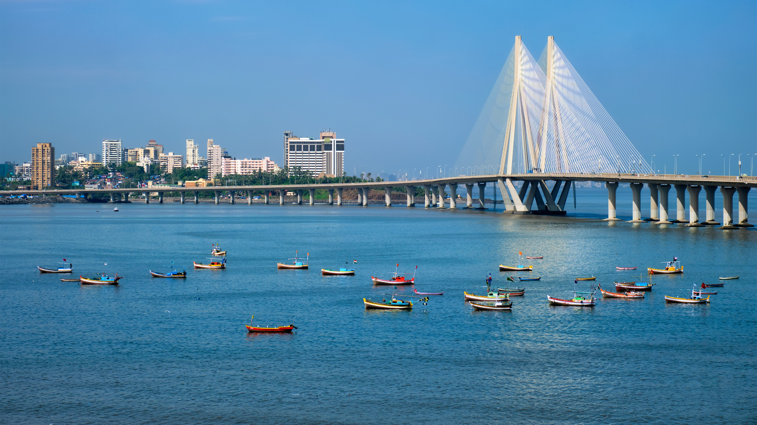
INHLIZIYO EPHENDUKEYO
ALL NATIONS GOSPEL PUBLISHERS
www.angp-hb.co.za

Slide 10
INHLIZIYO EPHENDUKEYO
Lesi sithombe sikhombisa inhliziyo yomuntu ozimisele ngaye
ukuthola ubuhlobo obuhle noNkulunkulu.
Njengoba ebona isiphambano ingelosi, iZwi likaNkulunkulu, elimbonisayo, liphula inhliziyo yakhe manje ezisolayo. Ushukunyiswa ukuzisola okujulile, okusuka enhliziyweni nokudabuka ngenxa yezono zakhe eziningi. Njengoba ebona uthando olukhulu lukaNkulunkulu olubonakaliswa kuKristu Jesu, lolu thando luncibilikisa inhliziyo yakhe. Uqala ukuqonda ukuthi uJesu Kristu, iNdodana kaNkulunkulu, weza ezosusa izono zakhe eziningi.
UJesu wayezimisele ukufa esikhundleni sakhe esiphambanweni.
O Nkulunkulu, dala kimi inhliziyo ehlanzekileyo,
futhi ufake kimi umoya omusha nokwethembeka.
( IHubo 51:10 )
Futhi, iZwi likaNkulunkulu lithi, Ngiyajabula ngalabo abathobekile nabaphendukayo, abangesabayo futhi bangilalele.
(Funda u-Isaya 66:2)
ALL NATIONS GOSPEL PUBLISHERS
www.angp-hb.co.za

Slide 11
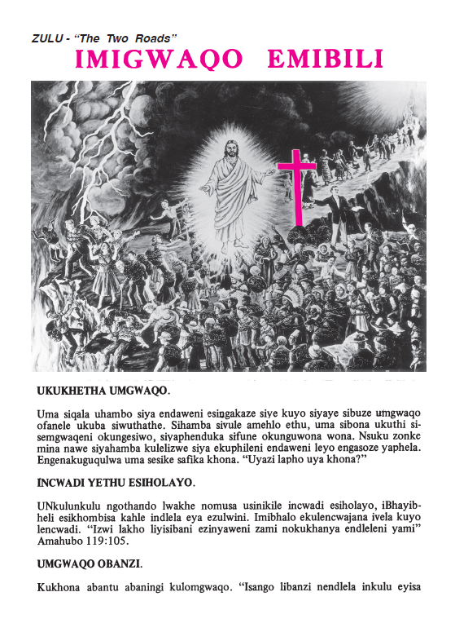
IMIGWAQO EMIBILI
ALL NATIONS GOSPEL PUBLISHERS
UKUKHETHA INDLELA
INCWADI YETHU YOMHLAHLANDLELA
UMGWAQO OBNZI
IMITHETHO
UNYAZI
UMLILO
INDLELA YOKUPHILA - UMSINDISI
UKUVUKA KWAKHE
IZULU
SINGAYIQALA KANJANI INDLELA EYA EZULWINI
INDLELA YOKUPHILA OKUSHA BUKHOMA
ALL NATIONS GOSPEL PUBLISHERS
www.angp-hb.co.za

Slide 12
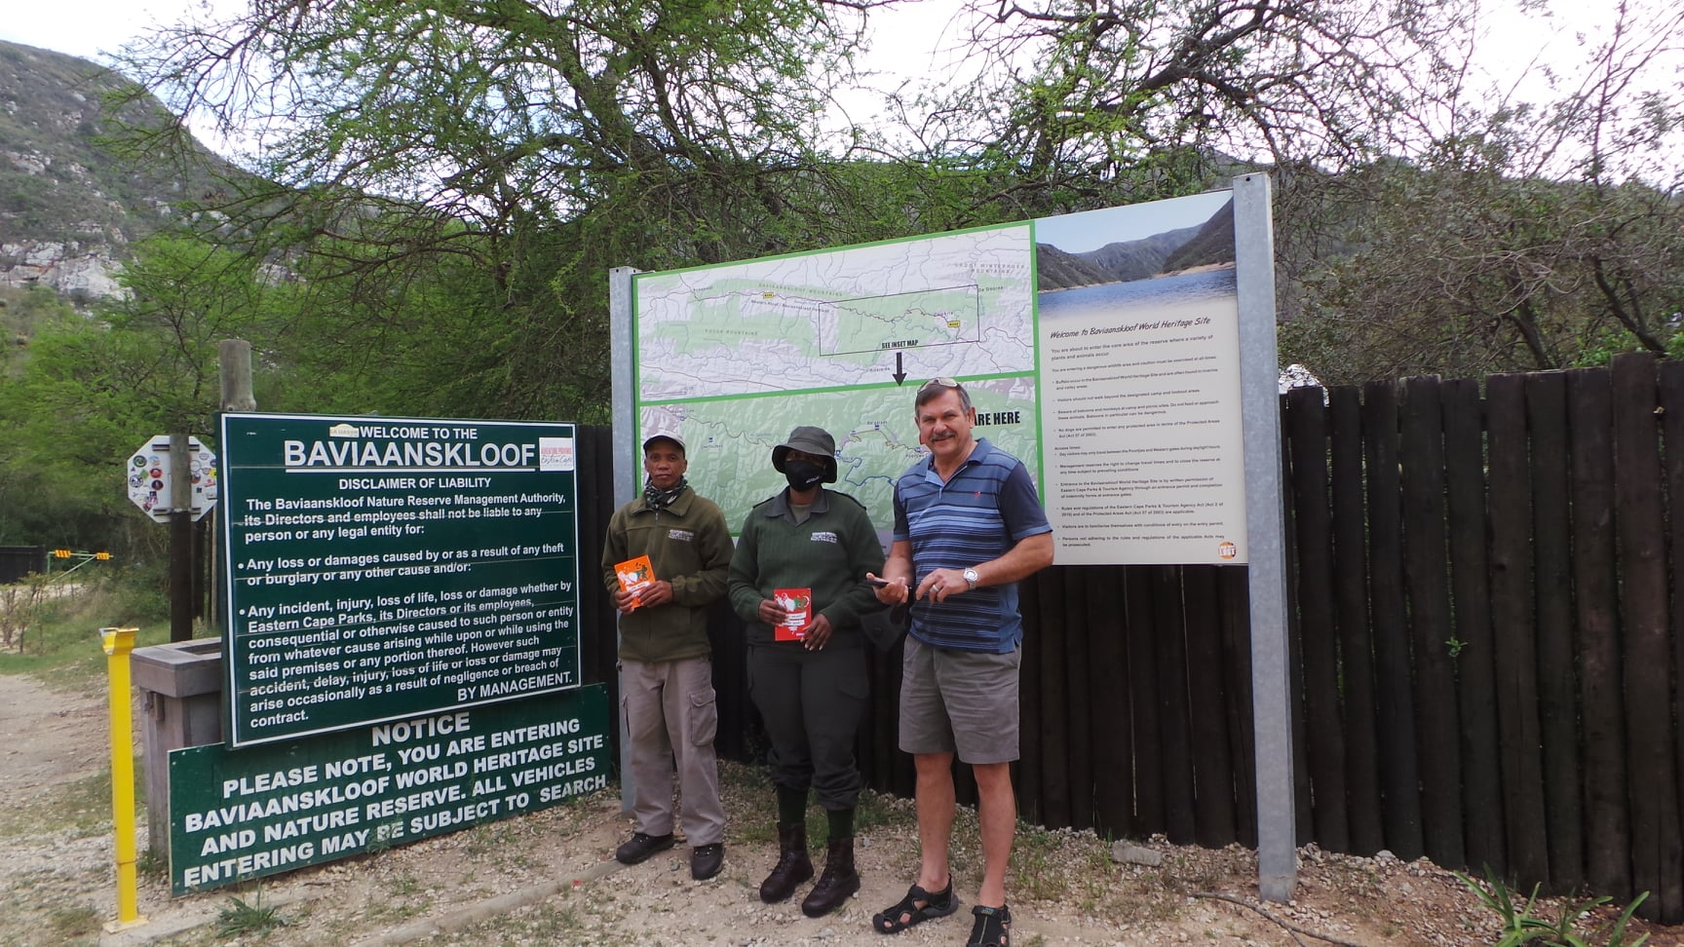
SINGAYIQALA KANJANI INDLELA EYA EZULWINI
Phendukani ezonweni zenu, nikholwe yizindaba ezinhle. ( Marku 1:15 )
Woza eNkosini uJesu Kristu, ngomkhuleko, njengoba nawe uthwele umthwalo wakho wesono, umcele ukuba akuthethelele. Uthi: Angisoze ngafulathela noma ubani oza kimi. ( Johane 6:37 ). Zanini kimi nina nonke enikhathele yimithwalo enzima, mina ngizakuniphumuza. (Mathewu 11:28 ).
Kholwa kuKristu kuphela ukuze ukhululwe esonweni.
Igazi likaJesu, iNdodana yaKhe, liyasihlanza kuzo zonke izono. ( 1 Johane 1:7 )
Uzokunika impilo entsha .... ukuphila okuphakade. UKristu wathi: Yilowo nalowo owezwa amazwi ami akholwe kongithumileyo unokuphila okuphakade. Kayikwahlulelwa, kodwa usedlulile ekufeni wangena ekuphileni. ( Johane 5:24 ). Uma umuntu ehlanganiswa noKristu, uyisidalwa esisha; okwakudala kudlulile, okusha sekufikile. ( 2 Korinte 5:17 ).
Uyoba nokuthula enhliziyweni yakho. Njengoba sesilungisisiwe kuNkulunkulu ngokukholwa, sinokuthula kuNkulunkulu ngeNkosi yethu uJesu Kristu. (KwabaseRoma 5:1 ). Yilobu ubufakazi: UNkulunkulu usinike ukuphila okuphakade, futhi lokhu kuphila kuvela eNdodaneni Yakhe. Onayo iNdodana unalokhu kuphila; ongenayo iNdodana kaNkulunkulu akanakho ukuphila. Nginilobela lokhu ukuze nazi ukuthi ninokuphila okuphakade nina enikholwa eNdodaneni kaNkulunkulu.
( 1 Johane 5:11-13 )

Slide 13

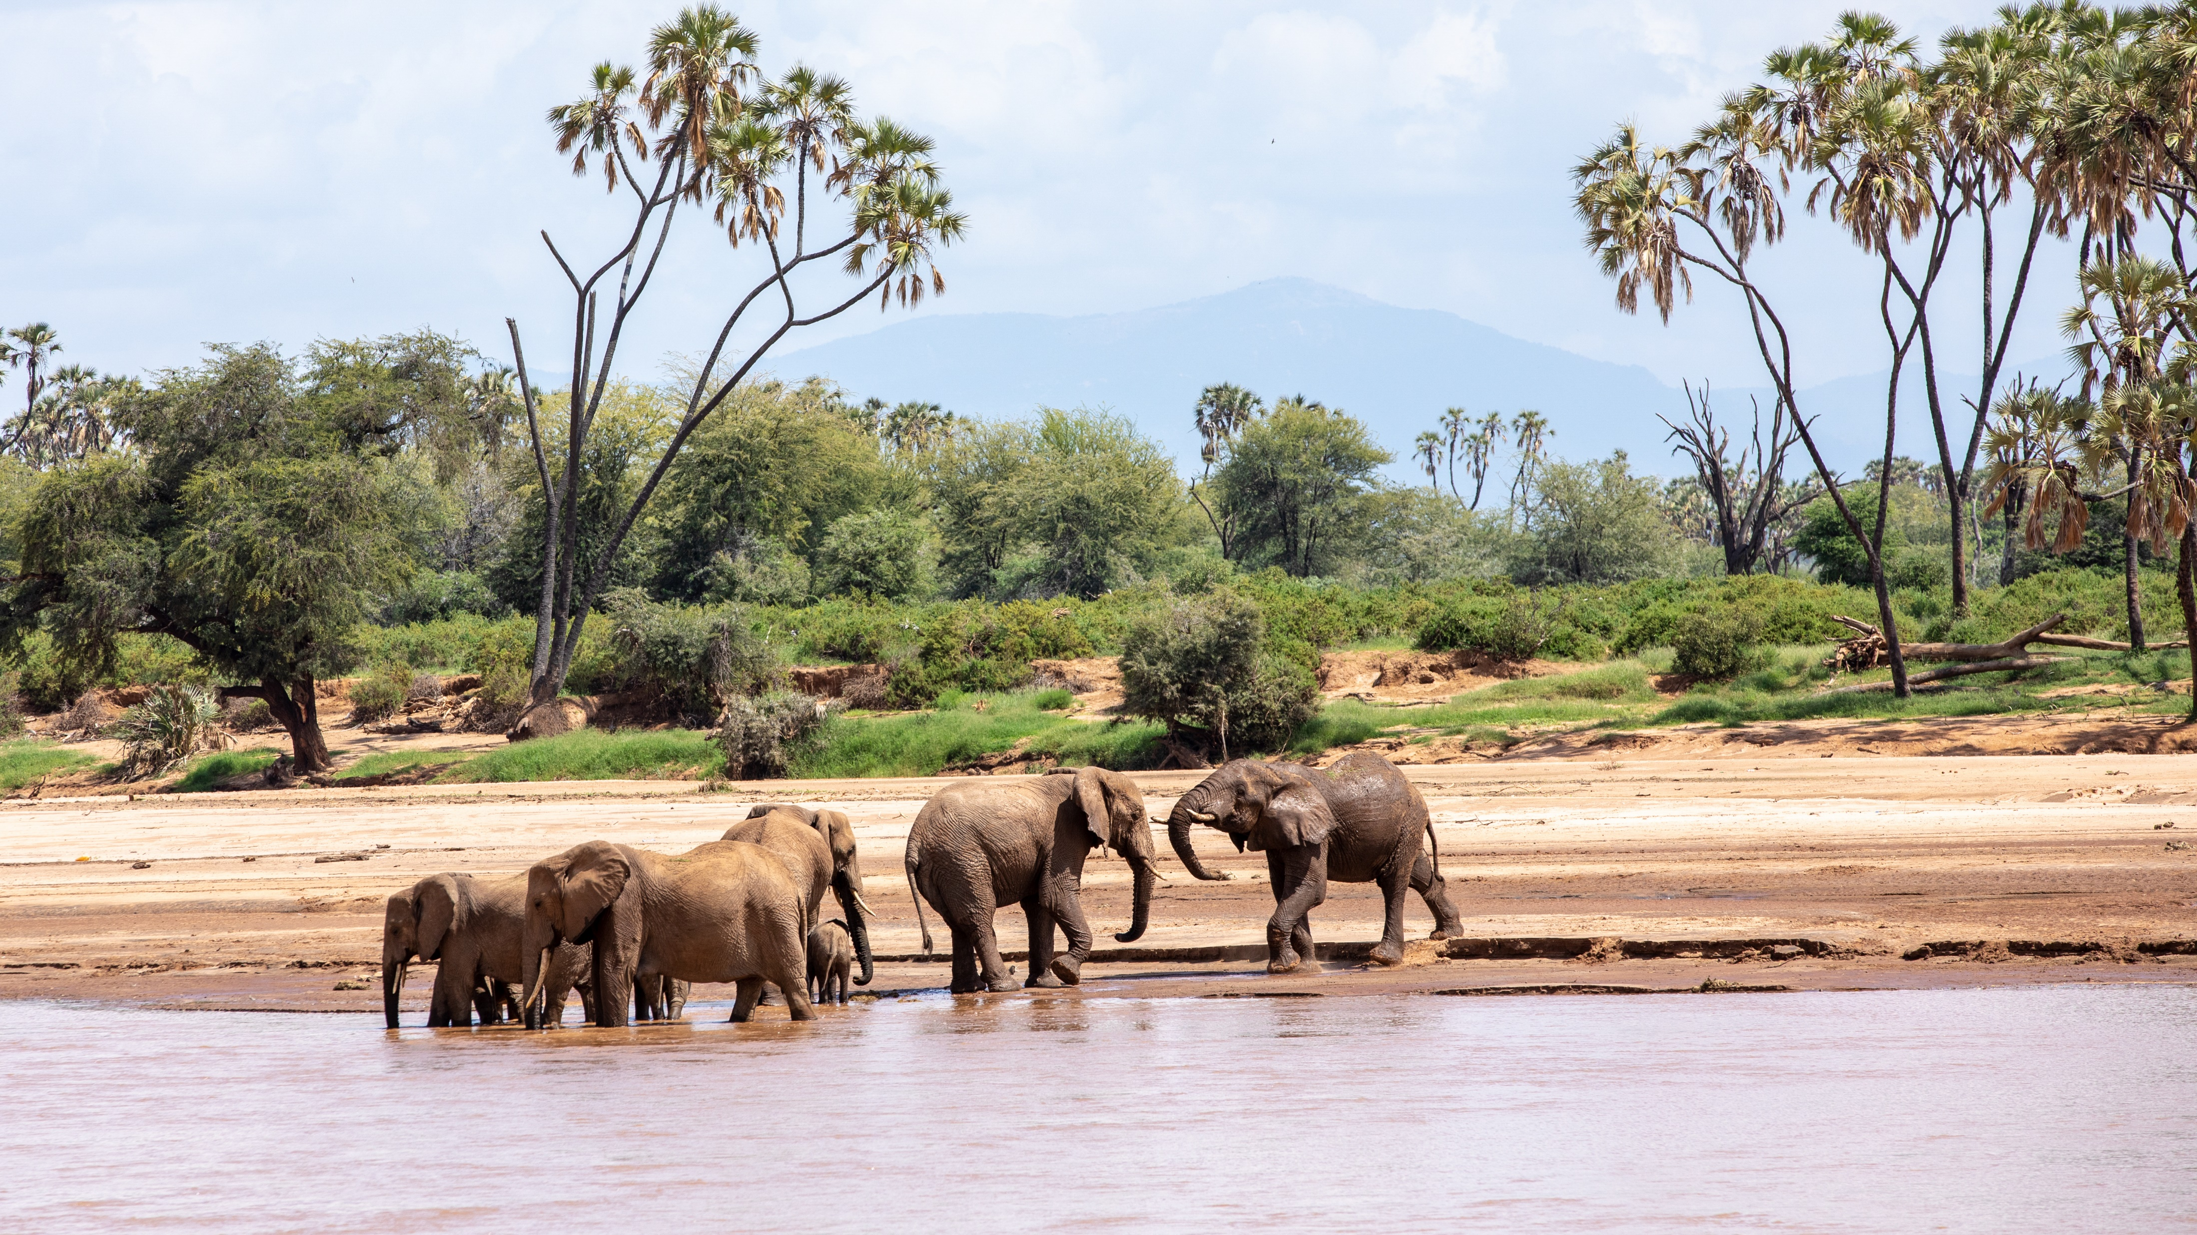
UKUFA NO KRISTU
ALL NATIONS GOSPEL PUBLISHERS
www.angp-hb.co.za

Slide 14
UKUFA NO KRISTU
Lesi sithombe sikhuluma ngomKristu othole ukuthula okuphelele nensindiso yaphakade ngokufa kwethu
INkosi noMsindisi, uJesu Kristu.
Lo muntu akaziqhayisi ngalutho ngaphandle kokuthi kuphela ngesiphambano seNkosi yethu uJesu Kristu; ngokuba ngesiphambano Sakhe izwe lifile kithi, nathi sifile kulo izwe.
(Galathiya 6:14). UJesu wafa esiphambanweni ukuze nathi ‘sife esonweni futhi siphilele ukulunga. ( 1 Petru 2:24 )
Ingabe uyamemezela obala ukuthi unikele inhliziyo yakho kuJesu Kristu, ngalokho okushoyo nokwenzayo?
Noma unamahloni ukwazisa abanye?
UJesu wathi, Uma umuntu evuma obala ukuthi ungowami, ngiyomenzela kanjalo phambi kukaBaba osezulwini. Kepha uma umuntu engala phambi kwabantu,
ngiyakumlahla phambi kukaBaba osezulwini.
( Mathewu 10:32-33 )
ALL NATIONS GOSPEL PUBLISHERS
www.angp-hb.co.za

Slide 15
UKUFA NOKRISTU – KUNGANI IBANDLA LIPHANDLE KWENHLIZIYO?
Baningi abazibiza ngamaKristu abakhulekayo, bahlanganyele esakramenteni lesidlo esingcwele, bahlabelele izingoma zikaNkulunkulu kanti nokho, ngezenzo zabo zesono, baphinde bethela iNdodana kaNkulunkulu esiphambanweni. (Funda amaHebheru 6-6).
Abantu bebonke bafuna ukuthola zonke izibusiso ezivela kuNkulunkulu, imvula yonke kanye nokukhanya kwelanga, kodwa abafuni ukuzibophezela ekukhonzeni uNkulunkulu njengeNkosi noMphathi wabo. Kwabaningi, uNkulunkulu muhle ngokwanele ukuba asize ngezikhathi zobunzima nokuphelelwa ithemba.
Akubona bonke abangibiza ngokuthi, ‘Nkosi. Nkosi,’ bayongena embusweni wezulu, kodwa kuphela labo abenza lokho uBaba osezulwini afuna ukuba bakwenze.
(Funda uMathewu 7:21-27.)
ALL NATIONS GOSPEL PUBLISHERS
www.angp-hb.co.za

Slide 16


ITHEMPELI LIKANKULUNKULU
ALL NATIONS GOSPEL PUBLISHERS
www.angp-hb.co.za

Slide 17
ITHEMPELI LIKANKULUNKULU
Lesi sithombe sibonisa inhliziyo ehlanzekile nehlanzekile yesoni esisindisiwe ngomusa nomusa kaNkulunkulu.
Inhliziyo manje isiyithempeli likaNkulunkulu langempela. Isono sixoshiwe. Esikhundleni sezilwane ezihlukahlukene ezilawulwa uSathane, uyise wamanga, sibona
UMoya oNgcwele, uMoya weQiniso, ophila enhliziyweni.
Esikhundleni sokuba indawo yokuzalanisa isono, inhliziyo isiphenduke isihlahla esihle, esithela izithelo noma insimu, ethela izithelo zikaMoya, ezinjengothando, injabulo, ukuthula, ukuthobeka, ukubekezela, umusa, ubuhle, ukwethembeka, ukuzithiba , kanye nokunye, okwamukelekayo nokujabulisa uNkulunkulu nakubantu.
(Galathiya 5: 22 - 23)
ALL NATIONS GOSPEL PUBLISHERS
www.angp-hb.co.za

Slide 18

INDLELA YOKUPHILA IMPILO ENTSHA
Funda iBhayibheli nsuku zonke. Ngaphandle kokuba ukukhanya endleleni yethu, kuwukudla komphefumulo. Yibani njengabantwana abasanda kuzalwa, bomele njalo ubisi olungokomoya olungenasici, ukuze ngokuluphuza nikhule. ( 1 Petru 2:2 ) Cela uNkulunkulu akuqondise futhi akufundise ngoMoya wakhe oNgcwele, njengoba ufunda.
Sondelani kuNkulunkulu ngomthandazo nsuku zonke, nikhuleka egameni likaJesu, Ningakhathazeki ngalutho, kepha emikhulekweni yenu yonke celani kuNkulunkulu enikudingayo, nimcele njalo ngenhliziyo ebongayo, nokuthula kukaNkulunkulu; okungaphezu kokuqonda komuntu kuyakugcina izinhliziyo zenu nemicabango yenu kuKristu Jesu. ( Filipi. 4:6,7 )
Khuluma nabanye ngoKristu. Buyela kwabakini ubatshele ukuthi kungakanani uJehova akwenzele kona nokuthi ube nomusa kuwe. ( Marku 5:19 )
Ekulingweni, biza iNkosi. Angabasiza abalingwayo, ngokuba yena walingwa futhi wahlupheka.
( Hebheru 2:18 )
Uma wenza isono futhi, sivume masinyane kuNkulunkulu. Kepha uma sizivuma izono zethu kuNkulunkulu, uyakusigcina isithembiso sakhe, enze ukulunga, asithethelele izono zethu, asihlanze kukho konke okubi. ( 1 Johane 1:9 )
Zama ukuzihlanganisa namanye amakholwa eNkosini uJesu Kristu. Umyalo wami yilo: Thandanani, njengoba nje nami nginithanda. ( Johane 15:12 )
Lalela uNkulunkulu ngaso sonke isikhathi. Ongithandayo uyakugcina imfundiso yami. ( Johane 14:23 )
Ningesabi, ngokuba uKristu unawe; Angisoze ngakushiya, angisoze ngakulahla. ( Hebheru 13:5 )
Zinikele ngokuphelele eNkosini uJesu Kristu. Mvumele aqondise impilo yakho ngokwentando yakhe.
Ngale ndlela uyothola injabulo yangempela.

Slide 19
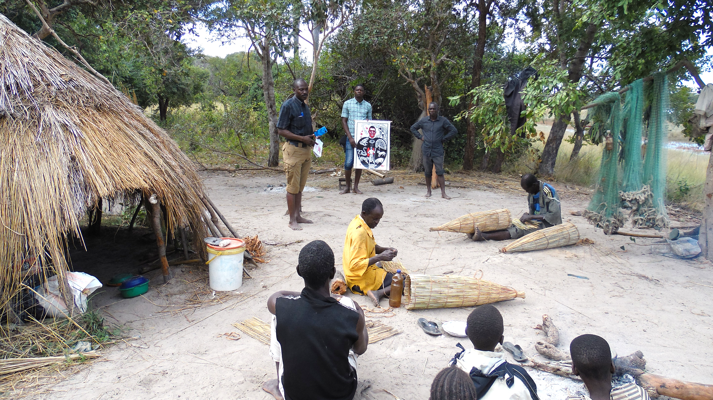

INHLIZIYO ENQOBI
ALL NATIONS GOSPEL PUBLISHERS
www.angp-hb.co.za

Slide 20
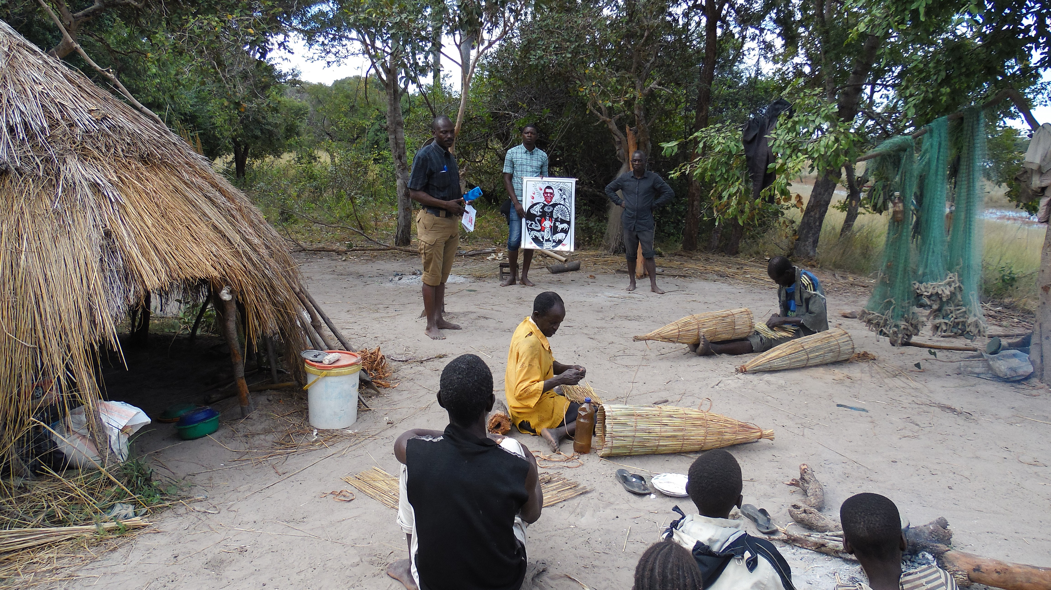
INHLIZIYO ENQOBI
Lesi sithombe sikhombisa umKristu ohlala ethembekile futhi onqobayo
ukunqoba izilingo ezibuhlungu nezilingo.
Nakuba elingwa nhlangothi zonke, uhlala eqinile futhi ebambelele kuze kube sekupheleni, enqoba ngoJesu Kristu. Akagcinanga ngokungena emncintiswaneni wobuKristu, kodwa uyaqhubeka kuwo, egijima ngokuzimisela, ‘egxilise amehlo akhe kuJesu, lowo ukholo lwethu luthembele kuye, kusukela ekuqaleni kuze kube sekupheleni.
(Hebheru 12:1 -2)
Lo muntu ulungele ukuhlangana noNkulunkulu futhi ufana nesihlahla esimila ngasemfudlaneni; othela isithelo ngesikhathi esifaneleyo; njengegatsha lomvini wangempela, lithela izithelo eziningi.
Uyawakhumbula amazwi kaJesu.
Nibusisiwe nxa abantu benithuka, benizingela, bekhuluma yonke inhlobo yobubi beqamba amanga ngani, ngokuba ningabalandeli bami. Jabulani nijabule, ngokuba umvuzo wenu mkhulu ezulwini.
( Mathewu 5: 11 - 12 )
ALL NATIONS GOSPEL PUBLISHERS
www.angp-hb.co.za

Slide 21
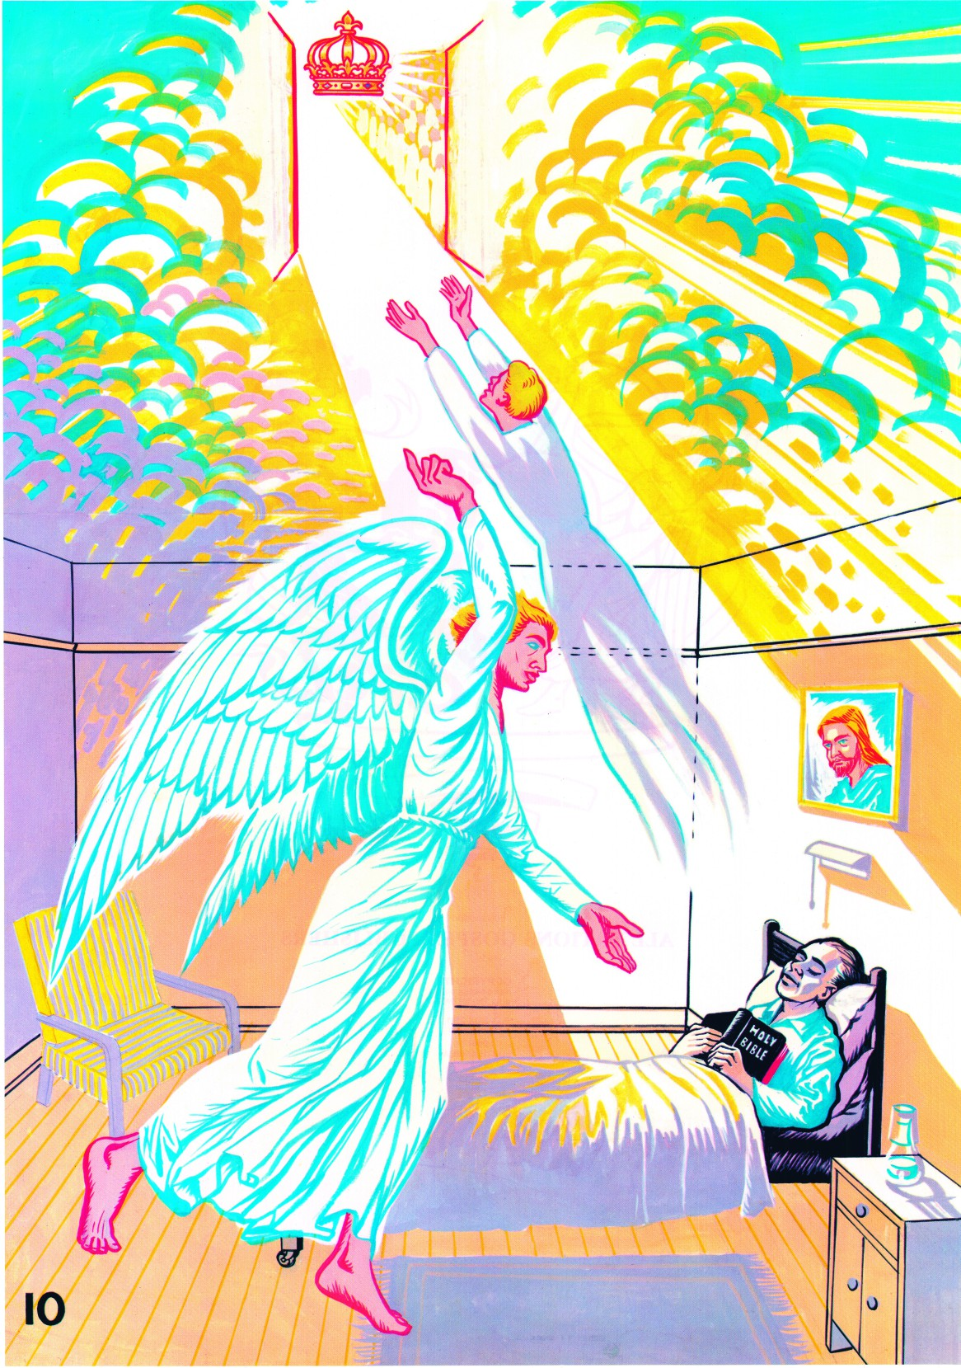
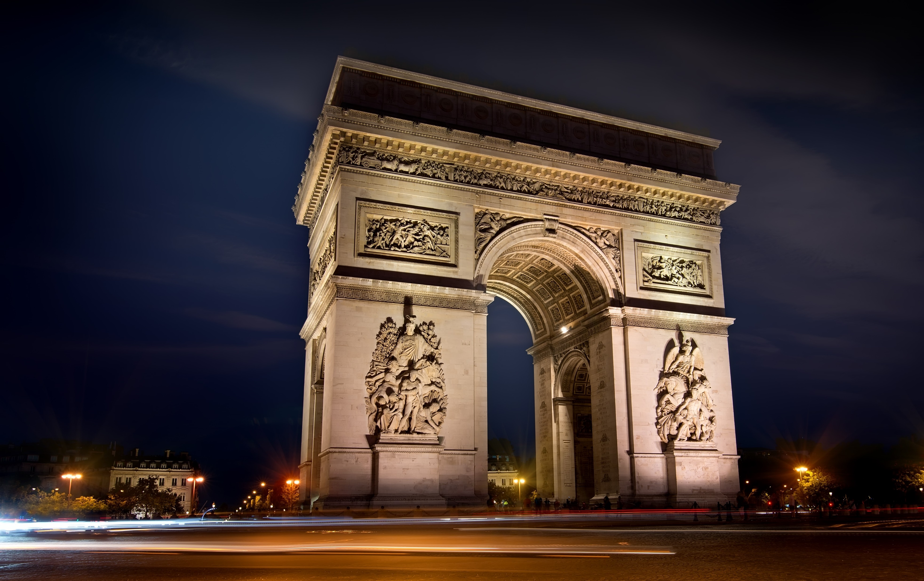
IKHAYA EKHAYA
ALL NATIONS GOSPEL PUBLISHERS
www.angp-hb.co.za

Slide 22
IKHAYA EKHAYA
UJesu wathi, Mina ngingukuvuka nokuphila. Okholwa yimi uyakuphila, noma efa; futhi lowo ophilayo akholwe kimi kasoze afa laphakade.
( Johane 11:25-26 )
Lowo owezwayo amazwi ami akholwe YIYO ongithumileyo, unokuphila okuphakade. Ngeke ahlulelwe kodwa usedlulile ekufeni wangena ekuphileni. ( Johane 5: 24 )
Ukufa akuphethe ukwesaba, noma isijeziso kumKristu. Ukufa kuyachithwa; ukunqoba kuphelele!
Kuphi ukufa ukunqoba kwakho? Akuphi ukufa amandla akho okulimaza?
Makabongwe uNkulunkulu osiphayo
ukunqoba ngeNkosi yethu uJesu Kristu!”
(1 Korinte 15: 54 - 57 )
Bayajabula labo kusukela manje kuqhubeke bafela enkonzweni yeNkosi!’ ‘Yebo ngempela!’ kuphendula uMoya. ‘Bayojabulela ukuphumula emsebenzini wabo onzima, ngoba imiphumela yenkonzo yabo
ihambisana nabo. (Funda isAmbulo 14:13 )
ALL NATIONS GOSPEL PUBLISHERS
www.angp-hb.co.za

Slide 23
INHLIZIYO YOMUNTU
INHLIZIYO YOSONI
INHLIZIYO EKHOLWE NGESONO
INHLIZIYO EPHENDUKEYO
UKUFA NO KRISTU
ITHEMPELI LIKANKULUNKULU
INHLIZIYO ENQOBI
IKHAYA EKHAYA
KUTHATHA ISIKHATHI ESINGAKANANI UKUFINYELELA
“INHLIZIYO ENQOBAYO”?
ESITHUPHA, ISIKHOMBISA kanye NESISHIYAGALOMBILI ???
www.angp-hb.co.za
ALL NATIONS GOSPEL PUBLISHERS

Slide 24
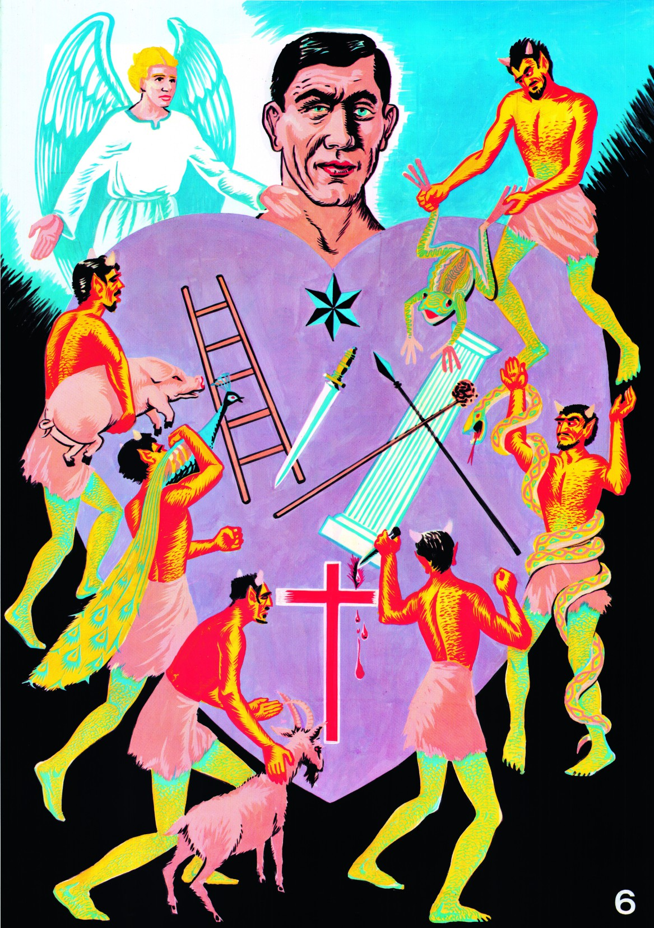



INHLIZIYO YOMUNTU
INHLIZIYO YOSONI
INHLIZIYO EKHOLWE NGESONO
INHLIZIYO EPHENDUKEYO
UKUFA NO KRISTU
ITHEMPELI LIKANKULUNKULU
INHLIZIYO ENQOBI
IKHAYA EKHAYA
Ocabanga ukuthi umile kungcono aqaphele angawi. (1 Korinte 10: 12)
…….. Bese uyaphuma ulethe abanye omoya abayisikhombisa ababi kakhulu kunawo, bafike bahlale khona. Ngakho, lapho konke sekuphelile, lowo muntu usesimweni esibi kakhulu kunalokho ayeyikho ekuqaleni.” (Luka 11: 24 - 26)
-----------------------------------------------------------------
Sukani kimi, nina eningaphansi kwesiqalekiso sikaNkulunkulu! kude emlilweni ophakade olungiselwe uSathane nezingelosi zakhe. (Mathewu 25: 41)
INHLIZIYO ELINGWAYO NEHLUKILE
INHLIZIYO EBUYILE NOMA ENINI
UKWAHLULELA KWESOONI
www.angp-hb.co.za
ALL NATIONS GOSPEL PUBLISHERS

Slide 25
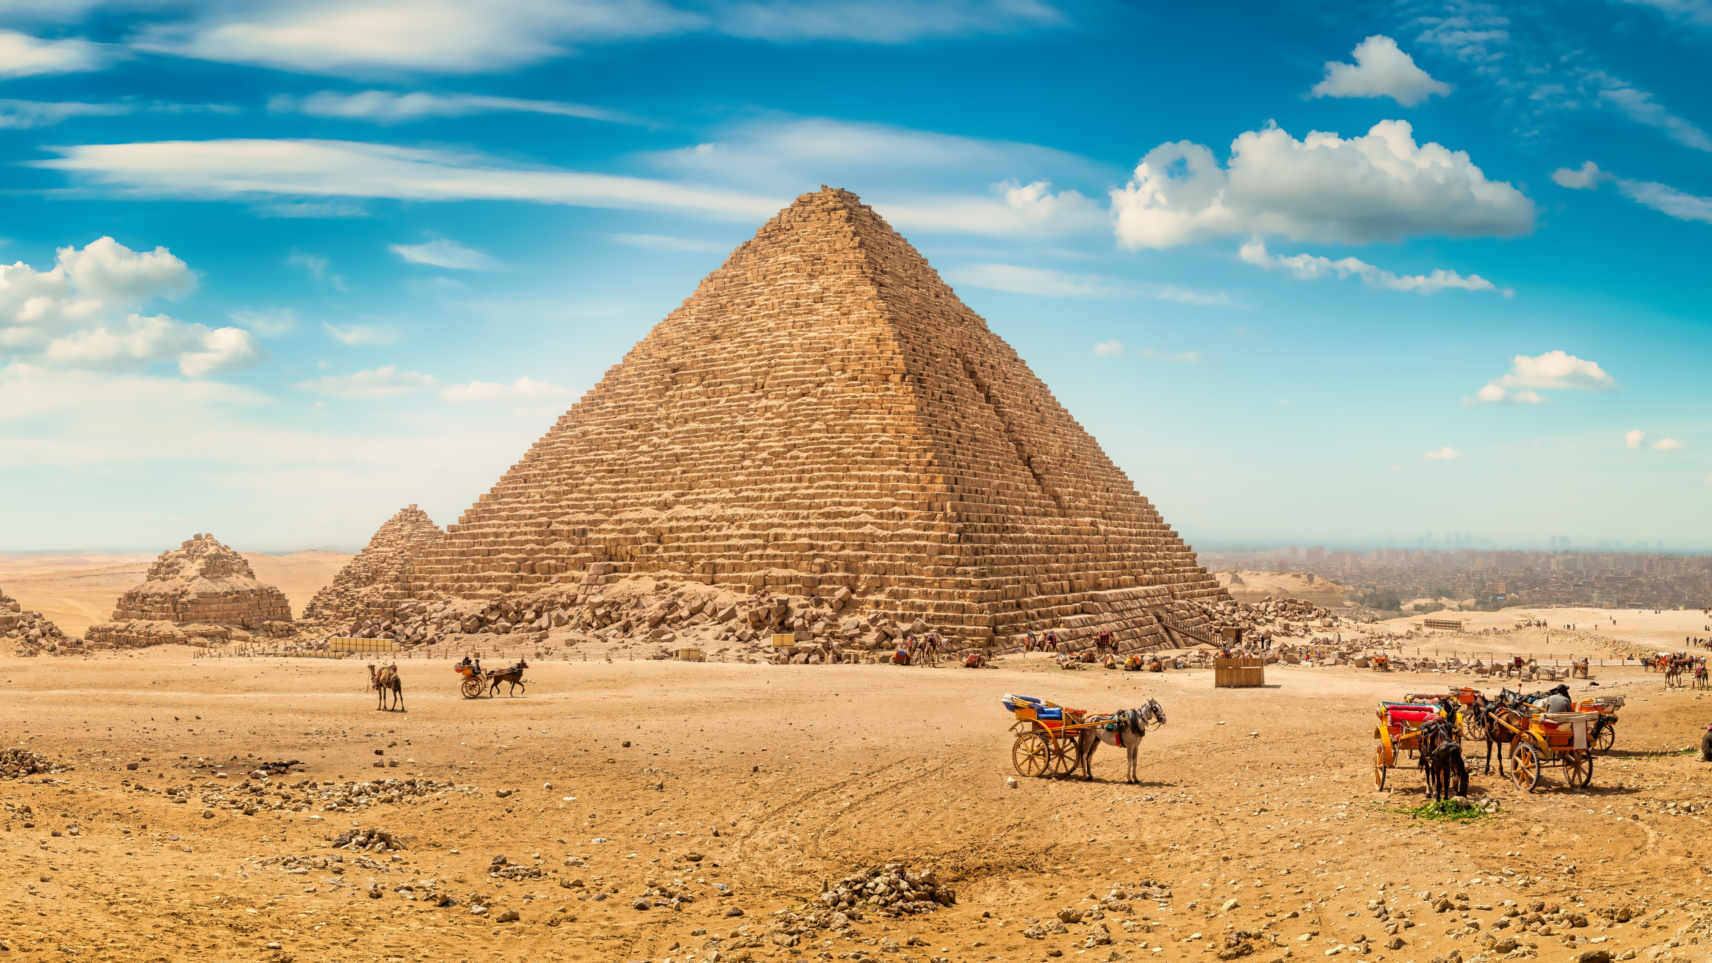
INHLIZIYO ELINGWAYO NEHLUKILE
ALL NATIONS GOSPEL PUBLISHERS
www.angp-hb.co.za

Slide 26
INHLIZIYO ELINGWAYO NEHLUKILE
Lesi isithombe esidabukisayo somuntu obuye wawa
ezindleleni zakhe zakudala.
Ukukhanya kwangaphakathi sekufiphele, nezithombe
ezisenhliziyweni yakhe,
ekhombisa ukulungela kwakhe ukuhlupheka kanye noKristu, sebewile futhi abasekho abaqotho. Uzungezwe izilingo azinikela kancane kancane, kunokuba amelane nazo. Esikhundleni sokulalela izwi likaNkulunkulu, manje uqala ukulalela iziphakamiso zobuqili zikadeveli nezithembiso ezingamanga.
Nakuba kungenzeka ukuthi usengumuntu osontayo, ofihla izifiso zakhe zezinto zezwe ngaphansi kohlobo oluthile lwenkolo,
uthando lukaNkulunkulu seluphole enhliziyweni yakhe.
Lalelani izixwayiso zeNkosi yethu uJesu lapho ithi:
Hlalani nilindile futhi nithandaze ukuba ningaweli esilingweni. (Mathewu 26: 41)
Ocabanga ukuthi umile kungcono aqaphele angawi.
(1 Korinte 10: 12)
ALL NATIONS GOSPEL PUBLISHERS
www.angp-hb.co.za

Slide 27
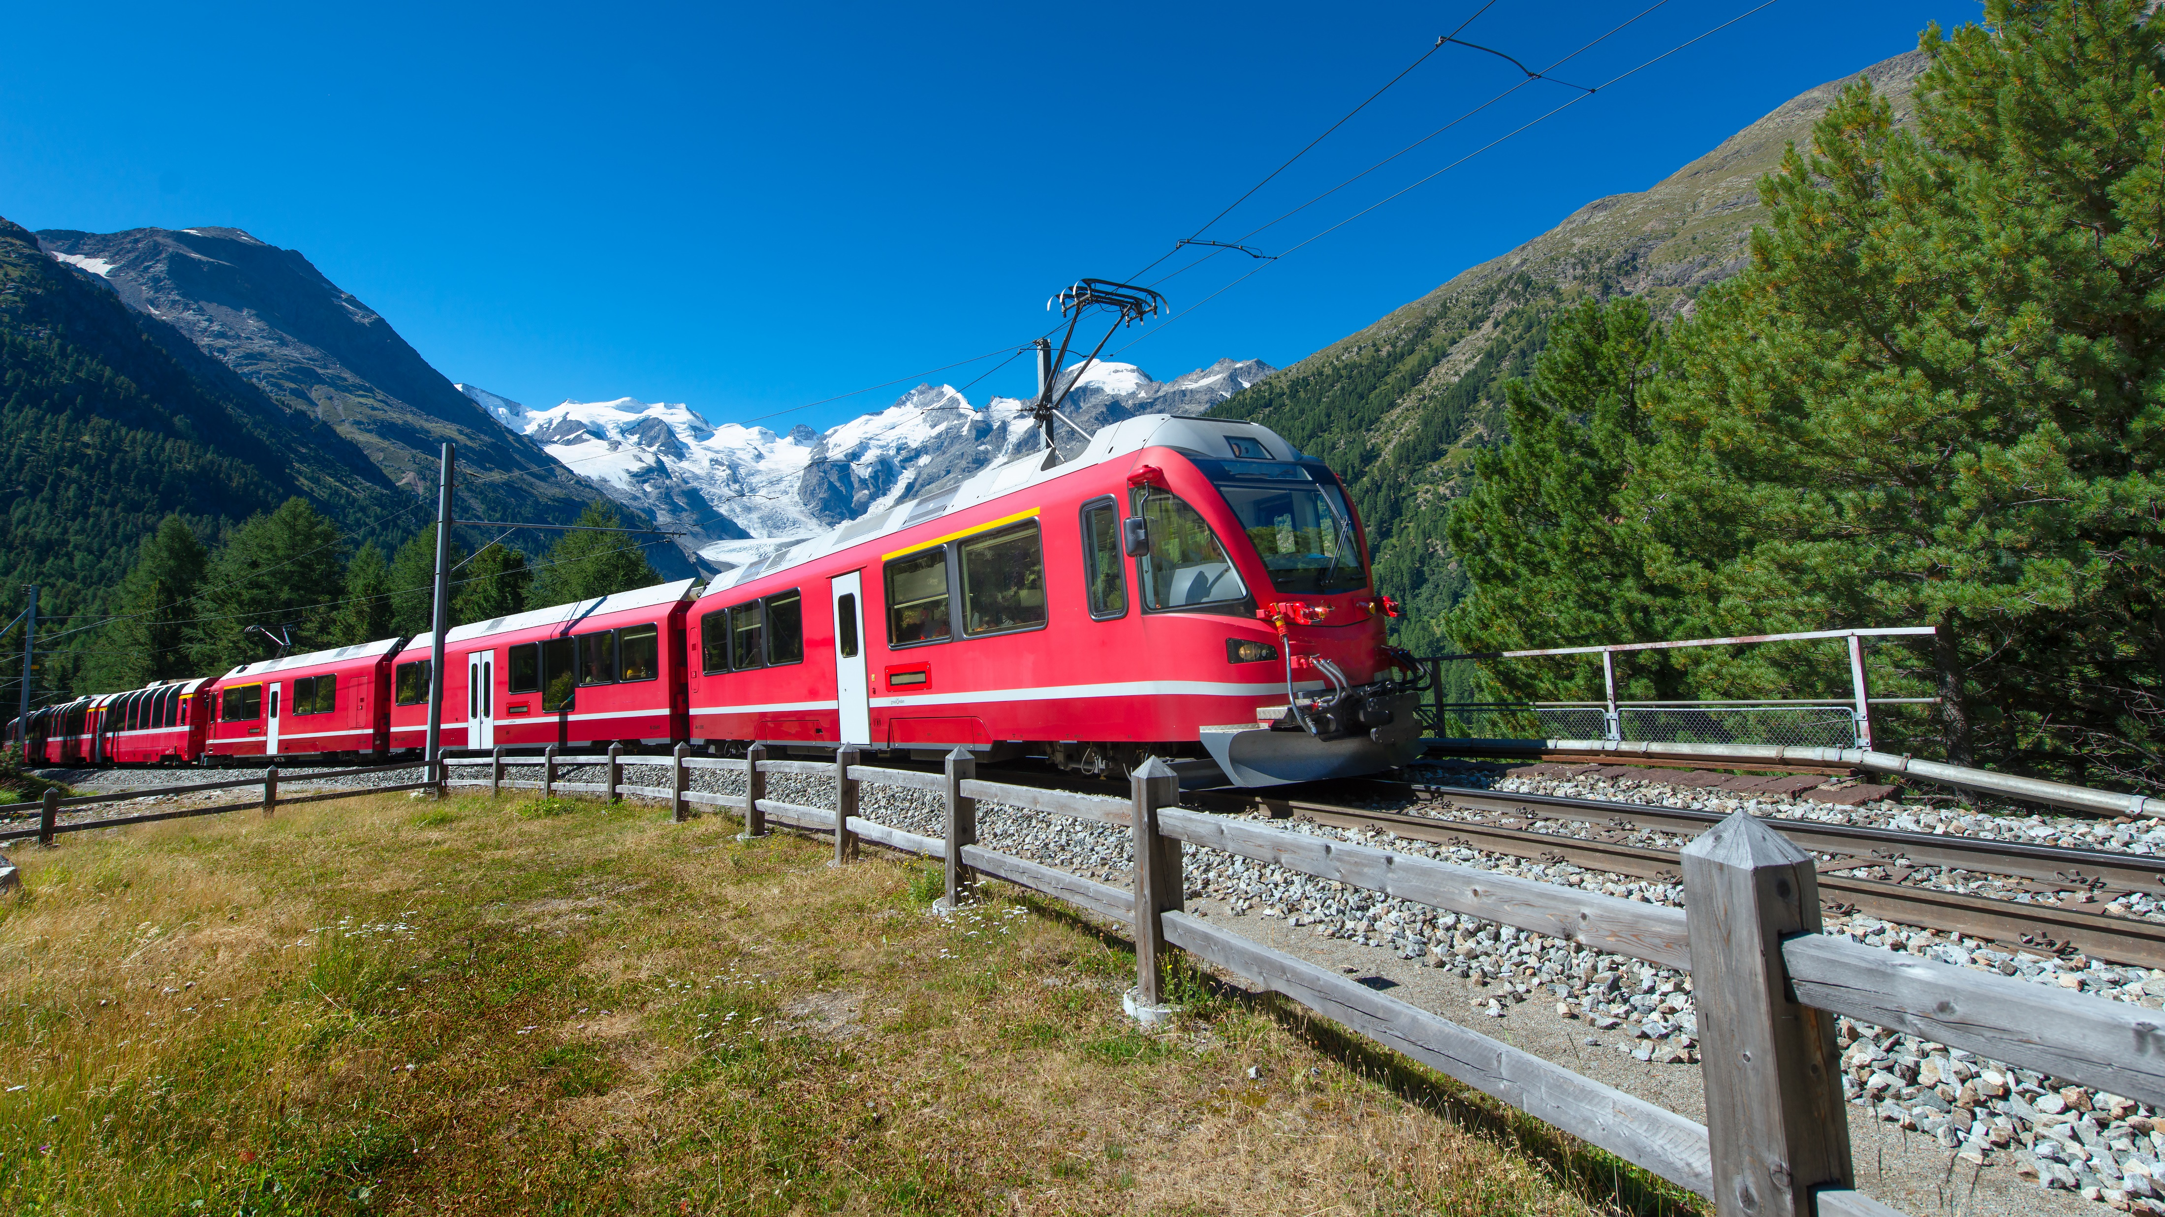
INHLIZIYO EBUYILE NOMA INENKANI
ALL NATIONS GOSPEL PUBLISHERS
www.angp-hb.co.za

Slide 28
INHLIZIYO EBUYILE NOMA INENKANI
Lesi sithombe siveza isimo somuntu osephinde wawela ngokuphelele ezindleleni zakhe zakudala, naphezu kwalokho uNkulunkulu amenzele kona.
UJesu ngokwakhe wamchaza lo muntu lapho ethi, Nxa idemoni liphuma kumuntu, liyahamba izwe elomileyo lifuna indawo yokuphumula. Uma ingakwazi ukuyithola, izitshela ukuthi, ‘Ngizobuyela endlini yami.’ Ngakho, ibuyela emuva futhi ithole indlu ihlanzekile futhi icocekile. Bese uyaphuma ulande abanye omoya abayisikhombisa ababi kakhulu kunawo, bafike bahlale khona; Ngakho, lapho konke sekuphelile, lowo muntu usesimweni esibi kakhulu kunalokho ayeyikho ekuqaleni. (Luka 11: 24 - 26)
Okwenzeka kubo kukhomba ukuthi izaga ziyiqiniso; ‘Inja ibuyela kulokho ebikuhlanzile’, futhi ‘Ingulube egeziwe ibuyela emuva ukuze igingqike odakeni.
(2 Petru 2:22)
ALL NATIONS GOSPEL PUBLISHERS
www.angp-hb.co.za

Slide 29
Ngakho, lapho konke sekuphelile, lowo muntu usesimweni esibi kakhulu kunalokho ayeyikho ekuqaleni
ALL NATIONS GOSPEL PUBLISHERS
www.angp-hb.co.za

Slide 30
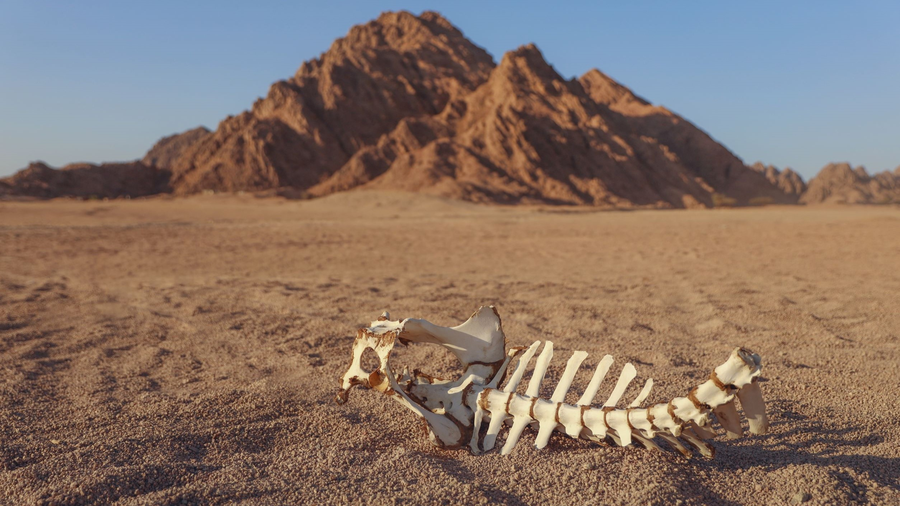
UKWAHLULELA KWESOONI
ALL NATIONS GOSPEL PUBLISHERS
www.angp-hb.co.za

Slide 31
UKWAHLULELA KWESOONI
Lapha sithola isoni esinenkani esasingafuni ukuphinda sivule inhliziyo yaso kuNkulunkulu.
Ukuzijabulisa okungamanga kwesono kunyamalele, futhi iqiniso elibi lezindleko eziphakeme nezesabekayo zesono kufanele kubhekwane nalo manje.
Abangane bakhe bayesaba ukuma eduze kombhede wakhe, futhi amazwi abo angenalutho enduduzo awakwazi ukumsiza manje. Ingcebo yakhe ngeke yelule ukuphila kwakhe, noma isindise umphefumulo wakhe, noma inciphise usizi lomphefumulo wakhe.
Lesi soni esifayo esenqaba intethelelo nothando lukaNkulunkulu ngesikhathi sokuphila kwaso manje kufanele sizwe izwi loMahluleli waso, uMsindisi esamala, lithi:
“Sukani kimi, nina eningaphansi kwesiqalekiso sikaNkulunkulu! kude emlilweni ophakade olungiselwe uSathane nezingelosi zakhe. (Mathewu 25: 41)
ALL NATIONS GOSPEL PUBLISHERS
www.angp-hb.co.za

Slide 32
INHLIZIYO YOMUNTU
INHLIZIYO YOSONI
INHLIZIYO EKHOLWE NGESONO
INHLIZIYO EPHENDUKEYO
UKUFA NO KRISTU
ITHEMPELI LIKANKULUNKULU
INHLIZIYO ENQOBI
IKHAYA EKHAYA
“Ocabanga ukuthi umile kungcono aqaphele angawi. (1 Korinte 10: 12)
…….. Bese uyaphuma ulethe abanye omoya abayisikhombisa ababi kakhulu kunawo, bafike bahlale khona. Ngakho, lapho konke sekuphelile, lowo muntu usesimweni esibi kakhulu kunalokho ayeyikho ekuqaleni.” (Luka 11: 24 - 26)
-----------------------------------------------------------------
Sukani kimi, nina eningaphansi kwesiqalekiso sikaNkulunkulu! kude emlilweni ophakade olungiselwe uSathane nezingelosi zakhe. (Mathewu 25: 41)
NAKUBA AKUMELE SIBE INGXENYE YALOKHU, KUSADINGA UKUBA SAZI UBUNGOZI BESONO.
INHLIZIYO ELINGWAYO NEHLUKILE
INHLIZIYO EBUYILE NOMA ENINI
UKWAHLULELA KWESOONI
www.angp-hb.co.za
ALL NATIONS GOSPEL PUBLISHERS

Slide 33
LOLUSUKU LUZOSIFELA SONKE.
USUKULUNGELE?

Slide 34

Kuye okwazi ukunigcina ningawi, futhi anilethe ningenasici futhi nijabula phambi kobukhona Bakhe obukhazimulayo—
kuNkulunkulu oyedwa uMsindisi wethu
ngoJesu Kristu iNkosi yethu.
makube yinkazimulo, nobukhosi, namandla, negunya,
kusukela kuyo yonke iminyaka edlule, manje, naphakade naphakade! Amen
Jude 24 - 25
Nawe onikele ukuphila kwakho kuNkulunkulu,
bambelelani niqinise emazwini aqinisileyo enganifundisa wona,
njengesibonelo sokuba usilandele,
futhi sihlale ekukholweni naseluthandweni lwethu ebunyeni noKristu Jesu.
2 Thimothewu 1:13
Mngane othandekayo, sengathi uNkulunkulu angakusiza ukuba unikele inhliziyo yakho kulowo okuthandayo,
ngokuba ukhuluma kini manje, ethi:
buyelani Kimi ngayo yonke inhliziyo yenu.
Duteronomi 30:2
ALL NATIONS GOSPEL PUBLISHERS
www.angp-hb.co.za

